Slide 1
Homeless Encampment
Complaint
ADLEY KIM, WENJIE ZHENG, JIANWEI LI, BORONG LYU, KEUNDEOK PARK

Slide 2
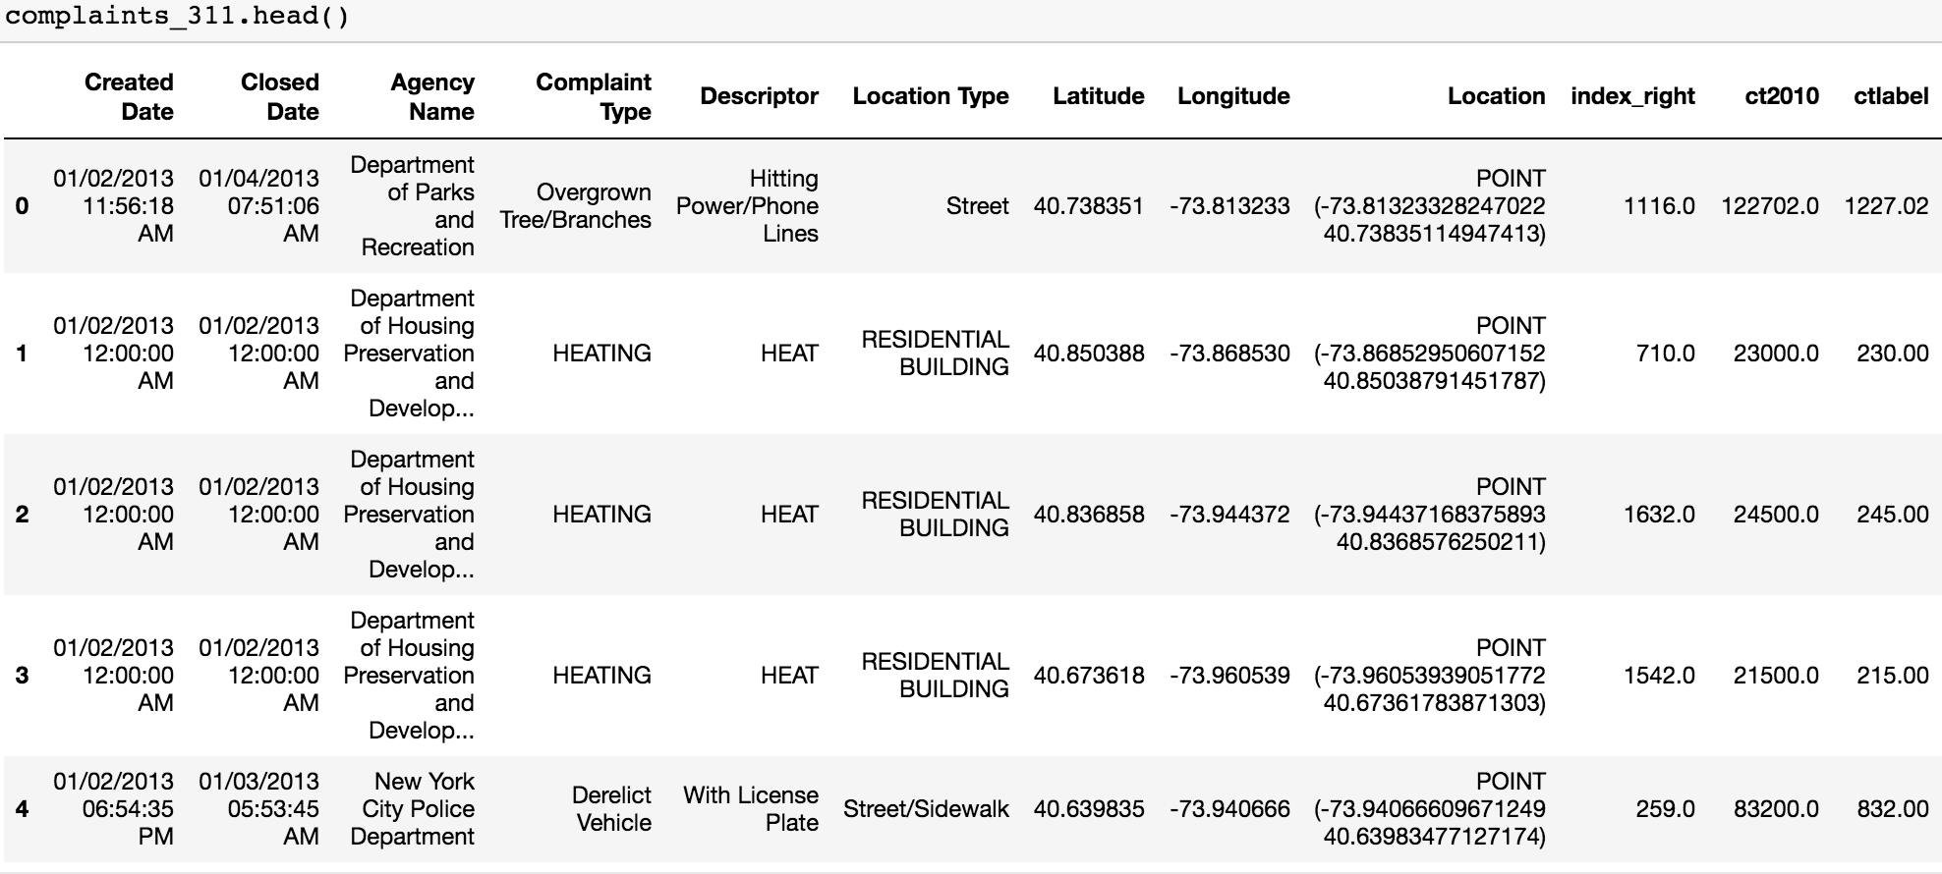
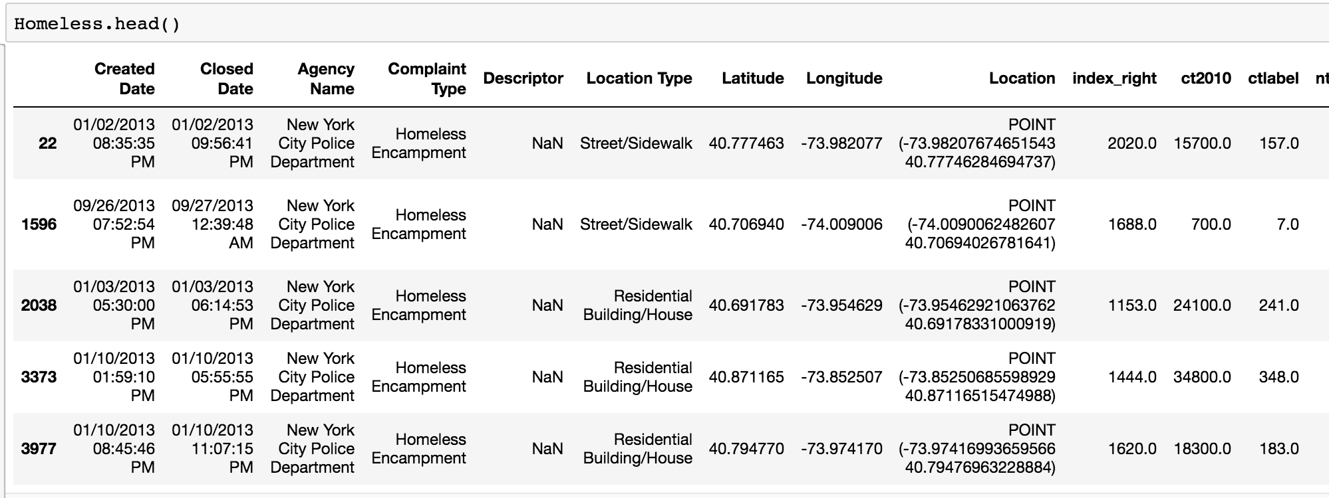
Introduction
311 Complaints
Issue of Homelessness

Slide 3
Research Question
Factors contribute to Homelessness.
Statistical measures on Homeless Encampment.
Do lower-income neighborhoods have more complaints about Homeless Encampment than higher-income neighborhoods?

Slide 4
311 Complaint Types
Complaint Types (n = 278)
The first level of a hierarchy identifying the topic of the incident or condition.
Meals Home Delivery Required Water Maintenance Sweeping/Missed-Inadequate Damaged or Dead Tree Illegal Animal-Sold/Kept Foam Bam Enforcement LEAD ATF Request Xmas Tree Collection Injured Wildlife Traffic/Illegal Parking OEM Disabled Vehicle Trapping Pigeon Hazardous Material Safety Health
…
Complaint Geocoding
latitude, longitude
zip code
borough

Slide 5
Data Sources
01
Source: NYC Open Data Portal
Size: 18.7m rows
Complaint Types: 278
311 SERVICE REQUESTS
(2010 - PRESENT)
02
Source: American Community Survey (2010)
Metric: Reported Income in Past 12 Months
Level: Census Tract
MEDIAN INCOME
03
Source: PLUTO Database
Count: 2168
Alias: Neighborhood Tabulation Area (NTA)
CENSUS TRACT
Notes:
https://api.census.gov/data/2016/acs/acs5?get=NAME,B19013_001E&for=tract:*&in=state:36&in=county:085,005,081,061,047
Bronx = Bronx County, Brooklyn = Kings County, Staten Island = Richmond County, Manhattan = New York County, Queens = Queens County

Slide 6
Data Processing
Homeless Encampment
(311)
Geocoded Complaints
PLUTO Census Tracts
Base Map
Cleaned Dataset
Income Data
Notes:
Remove missing values, negative values
Pick 10 typical complaints manually. Pick the most interesting one.
Use Moran’s i on PLUTO data to locate

Slide 7
Public Sectors & NGO
Department of Homeless Shelter
HOME-STAT— Homeless Outreach & Mobile Engagement Street Action Teams
DHS Homeless Shelter Census (each year)
Directory Of Homeless Drop- In Centers
NGP
Coalition of Homeless in NYC
StreetSmart App
Notes:
DHS Homeless Shelter Census
This dataset includes the daily number of families and individuals residing in the Department of Homeless Services (DHS) shelter system and the daily number of families applying to the DHS shelter system.

Slide 8
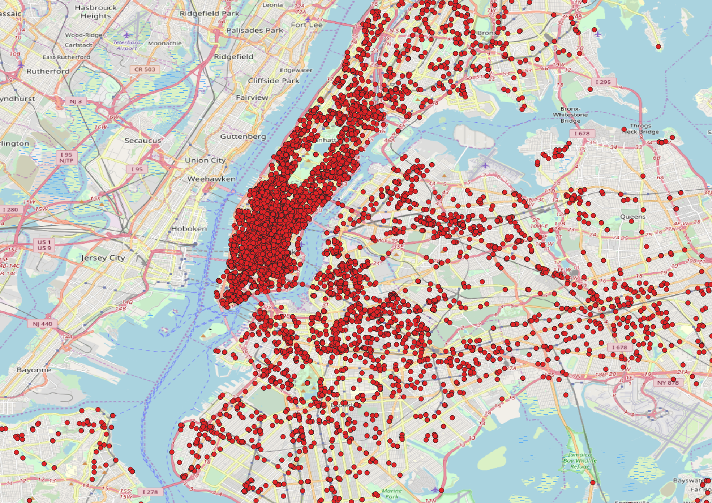
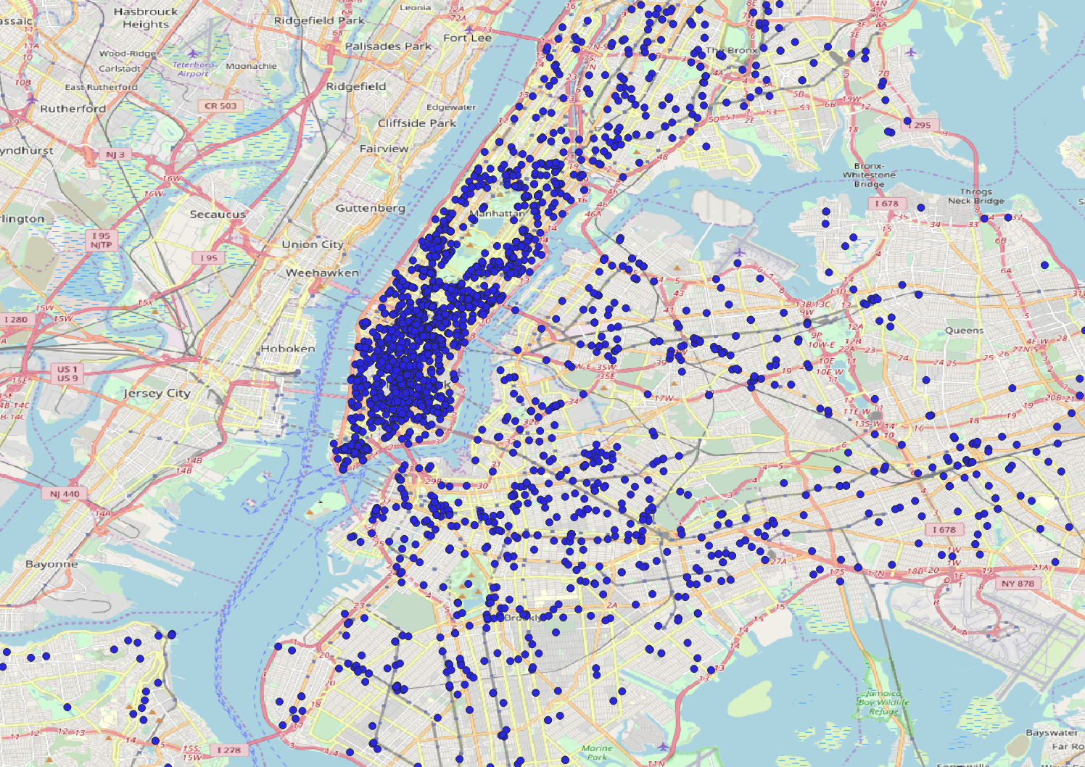
Summer(2011 ~ 2016, Jun., Jul., Aug.)
Winter(2011 ~ 2016, Dec., Jan., Feb.)

Slide 9
Questions?

